Slide 1
AKCİĞER KANSERİNDE DEĞİŞEN YAKLAŞIMLAR *Moderatörler : Nil Molinas Mandel , İlhan Öztop , Aytuğ Üner EVRE I-III KHDAK'DE TEDAVİ ALGORİTMASI
DR. Nilüfer Avcı
Bursa Medicana
12-15 KASIM 2020

Slide 2
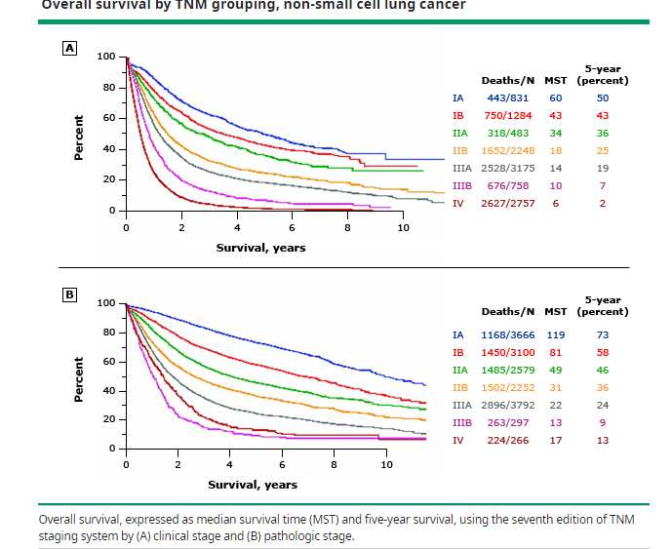
NSCL TNM göre OS

Slide 3
Erken evre AC Ca primer tedavi :cerrahi
EvreII-IIIA ve yüksek riskli evre IB de sisplatin bazlı adjuvan kemoterapi
Metaanalizlerde adjuvan KT ile 5 yıl OS HR:0.89, DFS HR:0.84 kemoterapi lehine
Rekürrens riskinde evre önemlidir.

Slide 6
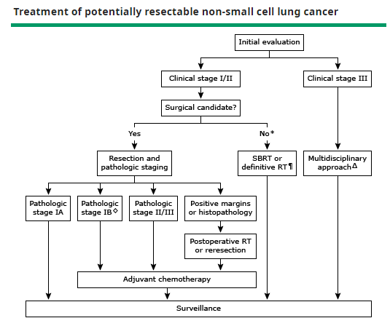

Slide 7
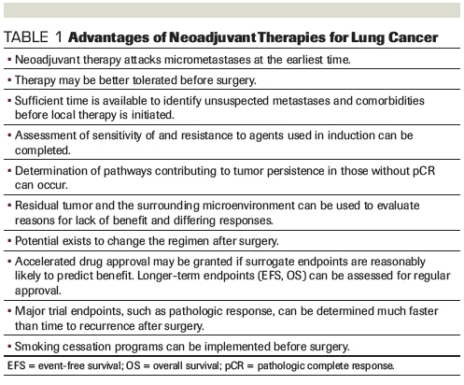

Slide 8
PATOLOJİK YÜKSEK RİSKLİ EVRE I

Slide 9
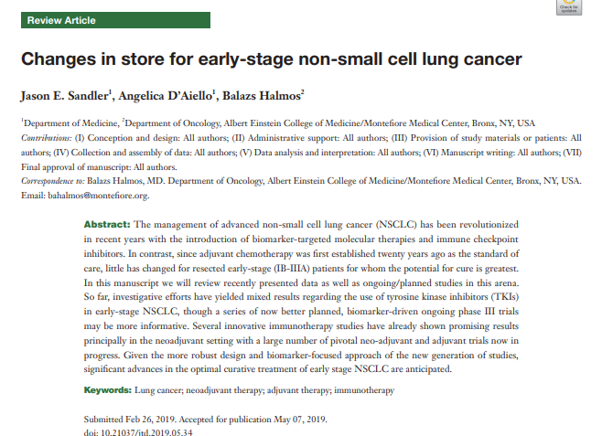
Cerrahiye adjuvan sisplatin bazlı KT eklenmesi
5 yıllık OS %5.4, DFS %5.8

Slide 10
MOLEKÜLER TEDAVİ

Slide 11
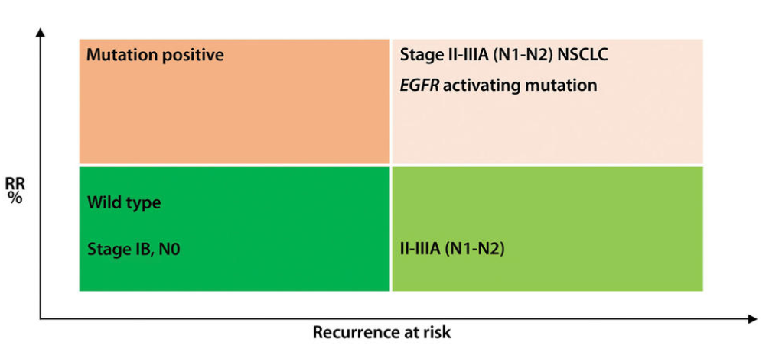
?????2010???
Gefitinib
Erlotinib
Osimertinib
Notes:
2010 yılında adjuvan EGFR TKİ nin KT ye kıyasla faydalı olabileceği düşünülmüş ve çalışmalar başlamıştır. Therefore, we planned this phase 2 trial to investigate whether or not adjuvant therapy with erlotinib was more effective and better tolerated than chemotherapy in a selected population of Chinese patients with EGFR mutation-positive, stage IIIA NSCLC who underwent complete (R0) resection. At the time of writing this report, the results of a phase 3 trial (ADJUVANT) in China were published and showed that adjuvant gefitinib, another EGFR TKI, increased disease-free survival compared with adjuvant chemotherapy in patients with stage II–IIIA NSCLC. the trials underway at the time (eg, the ADJUVANT study) enrolled broader patient populations, including patients with stage IA or II NSCLC. Therefore, for this trial, we decided to focus on patients with stage IIIA NSCLC in the hope of introducing an alternative to chemotherapy for these patients. Here, we present the results of our randomised phase 2 EVAN trial comparing erlotinib with chemotherapy in Chinese patients with stage IIIA EGFR mutation-positive NSCLC.

Slide 12
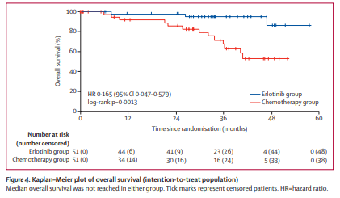
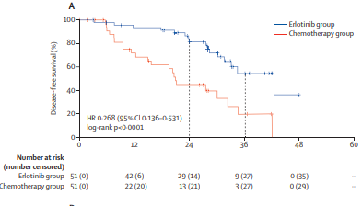
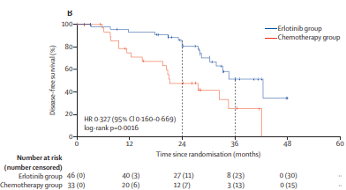
Faz II,18-75 yaş
R0 rezeksiyon patolojik Evre IIIA EGFR + NSCLC
Erlotinib 150mg/gün/2yıl x 4 kür vinorelbin+sisplatin
3yıllıkDFS %51.4 x%25
Notes:
n this randomised, open-label, phase 2 trial, eligible patients aged 18–75 years who had undergone complete (R0) resection of histologically or pathologically confirmed stage IIIA EGFR mutation-positive NSCLC and had not received any previous anticancer therapies were enrolled. Patients were randomly assigned (1:1) to receive either adjuvant erlotinib (150 mg once daily administered orally) or vinorelbine and cisplatin chemotherapy (four cycles of vinorelbine [25 mg/m intravenously on days 1 and 8 of each 21-day cycle] plus cisplatin [75 mg/m intravenously on day 1 of each 21-day cycle])
The results of this phase 2 trial show that adjuvant erlotinib improved 2-year disease-free survival compared with standard-of-care adjuvant chemotherapy in patients with completely resected (R0), EGFR mutation-positive stage IIIA NSCLC. At the data cutoff in our trial, overall survival data were immature; we are now endeavouring to continue follow-up to collect additional information for further analysis.

Slide 13
Osimertinib as adjuvant therapy in patients with stage IB–IIIA EGFR mutation positive NSCLC after complete tumor resection: ADAURA
Presented By Roy Herbst at TBD

Slide 14
Slide 5
Presented By Roy Herbst at TBD

Slide 15
Slide 6
Presented By Roy Herbst at TBD

Slide 16
Slide 7
Presented By Roy Herbst at TBD

Slide 17
Slide 8
Presented By Roy Herbst at TBD

Slide 18
Slide 9
Presented By Roy Herbst at TBD

Slide 19
Slide 10
Presented By Roy Herbst at TBD

Slide 20
Slide 11
Presented By Roy Herbst at TBD

Slide 21
Slide 12
Presented By Roy Herbst at TBD

Slide 22
Slide 14
Presented By Roy Herbst at TBD

Slide 23
Slide 16
Presented By Roy Herbst at TBD

Slide 24
SONUÇ OLARAK
Cerrahi rezeksiyon yapılmış tüm non-skuamöz küçük hücre dışı akciğer kanserinde EGFR mutasyonu bakılması ( kategori 2A)
Non-smokers skuamöz hücreli AC CA bakılabilir, ancak adjuvanda EGFR TKİ ??
EGFR mutasyonu postoperatif rekürrensin prediktifi
EGFR mutant AC Ca da beyin ve kemik metastazı riski wild tipe göre daha yüksek
Adjuvanda evre II-IIIA DFS iyileştirmiştir. Yüksek riskli evre IB de bir seçenek
Sadece EGFR TKİ?/ kemoterapi ve EGFR TKİ sekansiyel kullanım? / sadece KT?
Optimal tedavi, süresi ? En az 2 yıl
Adjuvan EGFR TKİ kullanımından sonra T790M gelişme olasılığı düşük, ancak yinede re-biyopsi yapılmalı ( SELECT trial). Ortalama rekürrens zamanı tedaviden sonra (erlotinib)25 ay
Notes:
one of the optional postoperative adjuvant treatments for patients with EGFR-mutant NSCLC. A clear postoperative EGFR mutation status helps to guide the choice of adjuvant therapy. Moreover, because different types of driver mutations suggest different biological behaviors, EGFR mutation status can predict the risk of postoperative recurrence (8) and the treatment failure patterns (9), which can guide the postoperative recurrence monitoring strategies and the drug selection after relapse. Therefore, for patients with non-squamous NSCLC, routine EGFR mutation testing is recommended after surgery. Imarkers such as TP53 mutation and tumor mutation burden (TMB) have been found to be prognostic (11,12). If

Slide 25
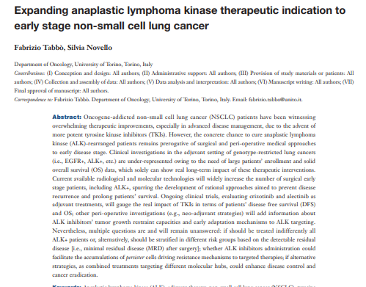
ALK+ erken evre AC CA N1/N2 pozitiflik daha yüksek
EGFR+ kanserlere göre, DFS ve ya RFS daha kısa, OS fark yok
Notes:
performed on resected lung adenocarcinoma with clinical N0 (absence of computed tomography or positron emission tomography detectable lymph node involvement), revealed an higher percentage of pathological N1 or N2 stage (37%) in ALK+ cases compared to other subgroups (EGFR+, KRAS+ or WT

Slide 26
ALCHEMİST TRİAL
Notes:
ALCHEMİST çalışması cerrahi sonrası nonskuamöz akciğer kanserinde genotipe ( ALK-EGFR) göre tedavi etkinliği araştırılmaktadır. standart tedavi (KT-RT) yi takiben genotipe göre erlotinib veya krizotinib verilmiştir.
ALCHEMIST-Immunotherapy (EA5142) is a proposed amendment to ALCHEMIST that will randomize patients with completely resected EGFR and ALK wild type tumors to nivolumab versus standard observation following standard therapy A comprehensive survey of all dysregulated pathways that coexist alongside and/or complement EGFR TK mutations and ALK rearrangement could potentially shed more light on the mechanisms of intrinsic and acquired resistance beyond what is known already. In addition, this study will be the first opportunity to systematically characterize the presence of other molecular changes, more specifically, changes in the broader class of cell signaling kinases that could potentially affect the outcomes in response to specific targeted therapies using rapidly emerging high throughput technologies.
Currently recruiting studies in adjuvant setting for ALK-rearranged patients are two phase III clinical trials: ALCHEMIST (NCT02194738) and ALINA (NCT03456076). The first one, taking advantage of wide genetic screening, enrolls stage IB (T ≥4 cm)-IIIA surgical treated patients after completion of standard of care treatments (chemotherapy and/or radiotherapy). ALK+ patients are randomized to receive crizotinib (at classical schedule of 250 mg bid) versus observation, up to 24 months of treatment, in absence of disease progression or unacceptable toxicities. Other two experimental arms contemplate erlotinib for EGFR mutated patients and nivolumab for double negative subgroup. OS is the first endpoint and DFS and Safety are secondary objectives

Slide 27
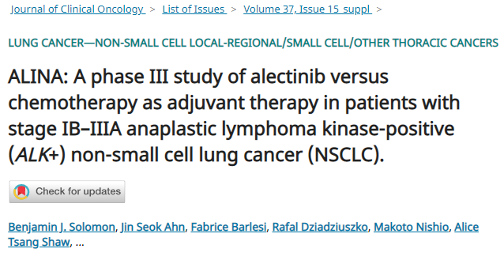
Çok merkezli fazIII
Opere evre II-IIIA, yüksek riskli IB (≥4 cm) ALK+ NSCLC
Alectinib 2x600mg/gün 24 ay
veya platin bazlı kemoterapi (sisplatin ve vinorelbin /gemsitabin/pemetrexed)
2018-2023
Primer sonlanım noktası:DFS,
Sekonder sonlanım noktası :OS
Notes:
The latter, ALINA, is a more recent randomized phase III trial designed to directly compare alectinib administration versus gold-standard treatment in ALK+ patients, histologically confirmed as IB (T ≥4 cm) to IIIA stage and surgically resected at 4–12 weeks before the enrollment. Stage IIIA(N2) patients potentially candidates to radiotherapy are not included (being considered a confounding high-risk subgroup). The experimental arm requires continuous therapy with alectinib at classical schedule of 600 mg bid for 24 months, whilst in the control arm patients receive platinum-based chemotherapy for 4 cycles. Primary endpoint is DFS and, secondary objective OS. Furthermore, alectinib’s pharmacokinetic features and possible adverse events are monitored during administration. The study, started in 2018, will be terminated in 2023,

Slide 28
İMMUNOTERAPİ
ADJUVAN
NEOADJUVAN

Slide 29
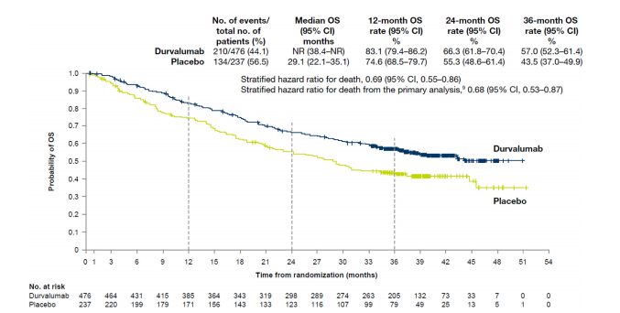
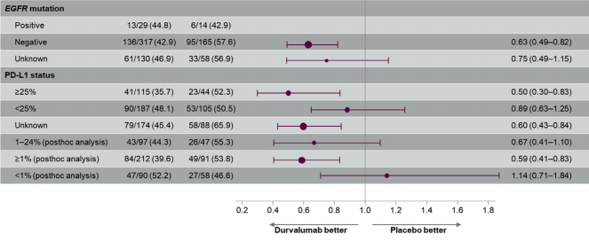
Evre III unresectable NSCLC
CRT sonrası
Durvalumab 10mg/kg 2 haftada bir 1 yıl
Notes:
Improved OS with durvalumab was broadly observed irrespective of PD-L1 expression, which is consistent with findings from prespecified and post hoc analyses carried out at the time of the primary OS analysis.8 This includes patients with unknown PD-L1 expression status, for whom median OS was improved by more than 20 months (versus placebo) at this update

Slide 30
BEKLENEN ÇALIŞMALAR

Slide 31
NEOADJUVAN TEDAVİDE İMMUNOTERAPİ
LCM3 çalışması ( the Lung Cancer Mutation Consortium’s):
*Evre IB - IIIB NSCLC(%46evre IIIA-B)
*N:101, vakaların 1/3 squamous histoloji, %90 smokers,
*PDL1 %50 negatif, N:7 EGFR-positif, :1 ALK translocation.
*Neoadjuvan 2 kür Atezolizumab ---cerrahi—adjuvan 1 yıl atezolizumab
*Primer sonlanım noktası major patolojik cevap
*Atezolizumab ile major patolojik cevap %19, CPR:%5
*PDL1 ekspresyonu ve tümör mutasyon yükü arasında anlamlı ilişki yok
NEOSTAR çalışması:
Notes:
2019 yılında ASCO da yayınlanan 2 önemli çalışma ile erken evre rezektabl akciğer kanserinde immunoterapi kullanımı önem kazanmıştır. Bu çalışmalar

Slide 32
Major PR:%17
Major PR:%33
Notes:
The rate of major pathologic response (≤ 10% viable tumor in the resected tumor specimen) NEOSTAR was a multiarm phase II study of checkpoint blockade for untreated stage I to IIIA (N2 single station) NSCLC amenable to surgical resection. Patients in arm A were treated with nivolumab, and those in arm B received the combination of nivolumab plus ipilimumab, based on preclinical studies showing synergy for this combination. All patients were scheduled for surgery within 3 to 6 weeks of the last dose of neoadjuvant immunotherapy. The primary endpoint of the study was the major pathologic response rate, defined as ≤ 10% viable tumor in resected tumor specimens after neoadjuvant therapy. Vakaların 2/3 adenokanserdir

Slide 35
NEOADJUVAN TEDAVİDE KEMO-İMMUNOTERAPİ
Notes:
Patients received the following drugs intravenously, as neoadjuvant treatment: nivolumab (360 mg), paclitaxel (200 mg/m²), and carboplatin (area under the curve 6; 6 mg/mL per min), on day 1 of each 21-day cycle, for three cycles before surgical resection. After completion of neoadjuvant chemoimmunotherapy, surgery was planned 42–49 days after the first day of the third treatment cycle. Resection of the primary tumour and lymph nodes was done according to standard institutional procedures. Once the patients were deemed fully recovered from surgery, adjuvant treatment with nivolumab was scheduled to commence 3–8 weeks after surgery. Patients received intravenous nivolumab as adjuvant treatment at a fixed dose of 240 mg every 2 weeks for 4 months, followed by a fixed dose of 480 mg every 4 weeks, until month 12.

Slide 36
24ay
PFS:%77
24ay
OS:%90
Notes:
treatment with neoadjuvant nivolumab did not delay planned surgery, and at 24 months, progression-free survival was 77% and overall survival was 90%.

Slide 37
CPR/MPR gelişen hastaların %58’de PDL1 TPS <%25
Notes:
Similar associations between PD-L1 expression and major pathological response have been observed in ongoing neoadjuvant immunotherapy trials with similar limitations in biomarker sensitivity.23,24 PD-L1 expression and tumour mutational burden were not associated with survival, extending to the neoadjuvant setting the finding of an absence of association between tumour mutational burden and survival in patients treated with chemoimmunotherapy combinations. The presence of specific mutations (STK11, KEAP1, RB1, and EGFR) was associated with reduced progression-free survival, reinforcing their negative role in terms of survival observed in previous studies,26–29 and supporting their future consideration in clinical trials.

Slide 38
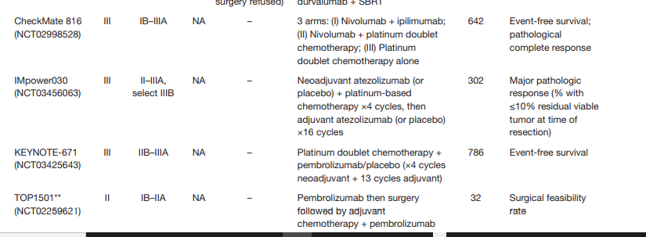
NEOADJUVAN KEMO-İMMUNOTERAPİ BEKLENEN ÇALIŞMALAR

Slide 39
LOKAL İLERİ AC CA KEMORADYOTERAPİ VE İMMUNOTERAPİ
Neoadjuvan KRT ile pCR:%28-38
Notes:
. As pathological complete responses (pCR) in resected specimens are seen in only a minority (28–38%) of patients following chemoradiotherapy, we designed the INCREASE trial (EudraCT-Number: 2019–003454-83; Netherlands Trial Register number: NL8435) to assess if pCR rates could be further improved by adding short course immunotherapy to induction chemoradiotherapy. Translational studies will correlate changes in loco-regional and systemic immune status with patterns of recurrence.

Slide 40
Lokal ileri evre III NSCLC
Platin bazlı kemoradyoterapi ile eş zamanlı
Nivolumab ilk 4 kür 360mg 21 günde bir
Daha sonra nivolumab 480mg 4 haftada bir en az 1yılın üzerinde veya progresyona kadar verilmiş
Primer sonlanım noktası 6 ayın sonunda grade 3 pnömonitis
Notes:
NICOLAS (NCT02434081) is a single-arm phase-II trial evaluating the safety and efficacy of the addition of concurrent anti-PD-1 nivolumab to standard first-line CRT in locally advanced stage III NSCLC.
Vaka sayısı :80, olup sadece 3 hasta sekansiyel tedavi almıştır. Vakaların çoğu 62 yaş, erkek, sigara içici ve evre 3b dir. 16 HASTA PROTOKOLÜ TAMALAYABİLMİŞ VE 1 YILIN ÜZERİBNDE NİVOLUMAB ALMIŞTIR. We acknowledge that the mortality rate observed in this clinical trial was higher than in other series (not too high, though, e.g., treatment-related death was more than 5% in the PACIFIC trial [4,5]), pointing to the fact that a larger number of patients treated with this regimen is needed, in order to evaluate in a multivariate analysis the potential factors contributing to patients’ outcome beyond lung toxicity. In conclusion, NICOLAS demonstrates the feasibility of CRT combination with concurrent and maintenance nivolumab in unresectable stage III NSCLC, with no unexpected adverse events or increased severe pneumonitis risk observed. The 1-year PFS will be evaluated according to the hierarchical design in the expanded cohort of all patients enrolled.

Slide 41
the INCREASE trial
5 yıl OS: %50
PCR: %60-70 artırdı
Notes:
Ipilimumab plus nivolumab and chemoradiotherapy followed by surgery in patients with resectable and borderline resectable T3-4N0–1 non-small cell lung cancer: the INCREASE trialOn day 1 of guideline-recommended concurrent chemoradiotherapy (CRT), ipilimumab (IPI, 1 mg/kg IV) and nivolumab (NIVO, 360 mg flat dose IV, ) will be administered, followed by nivolumab (360 mg flat dose IV) after 3 weeks. Radiotherapy consists of once-daily doses of 2 Gy to a total of 50 Gy, and chemotherapy will consist of a platinum-doublet, 2kür. An anatomical pulmonary resection is planned 6 weeks after the last day of radiotherapy. The primary study objective is to establish the safety of adding IPI/NIVO to pre-operative CRT, and its impact on pathological tumor response. Secondary objectives are to assess the impact of adding IPI/NIVO to CRT on disease free and overall survival. Exploratory objectives are to characterize tumor inflammation and the immune contexture in the tumor and tumor-draining lymph nodes (TDLN), and to explore the effects of IPI/NIVO and CRT and surgery

Slide 42
DETERRED çalışması, fazII
1. KOLDA (n:10) wPak-karbo- RT ile eş zamanlı
Takiben 2 siklus pak-karbo-atezolizumab ve atezolizumab 1 yıl idame
2. KOLDA (n:30)wPak-karbo-ATEZO- RT ile eş zamanlı
Takiben 2 siklus pak-karbo-atezolizumab ve atezolizumab 1 yıl idame
Primer sonlanım noktası güvenlik
1.kolda:%40 grade 3 artrlji, dispne, fistül
2. kolda:%23 yan etki diyare, nephrit, dispne, halsizlik ve kalp yetersizliği
İkincil sonlanım noktası PFS-OS
1 yıllık PFS%50 , OS %79 dur.
2019 ASCO

Slide 43
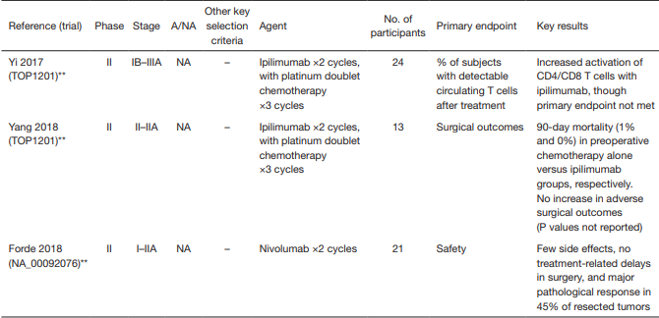
DEVAM EDEN ÇALIŞMALAR

Slide 44
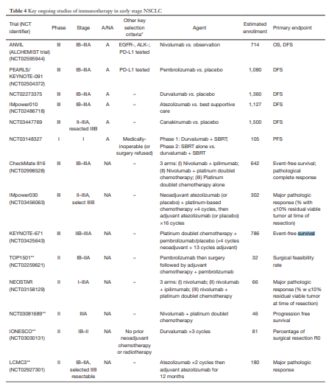

Slide 45
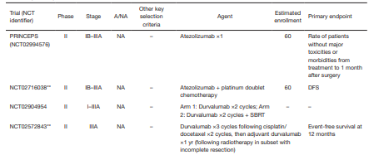

Slide 46
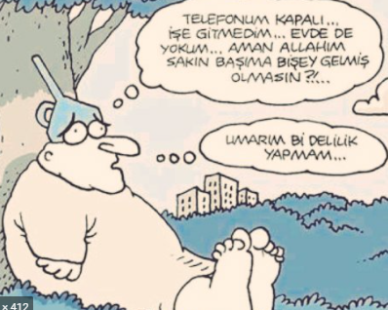
TEŞEKKÜR EDERİM

