Slide 1

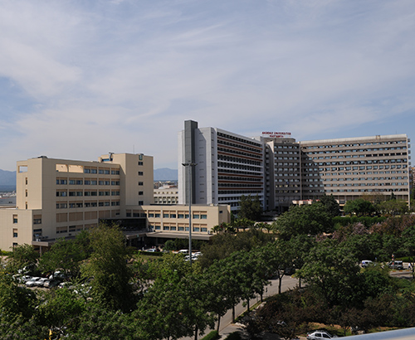
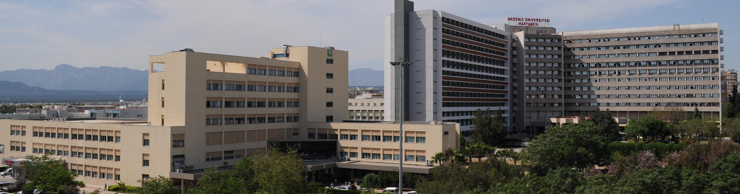
PROSTAT KANSERİ
Akdeniz Üniversitesi
Tıp Fakültesi
Tıbbi Onkoloji BD
Dr. Hasan Şenol COŞKUN
2020

Slide 2
Neler konuşalım?
Özet
Genel
HSMPK
MKDPK
MO KDPK
Soru Katkı

Slide 3
Yaşlandıkça sık

Slide 4
Yaşam süresi

Slide 5
LHRH Analogları
LHRH Antagonistleri
Antiandrojen
Abirateron
Enzalutamid
Apalutamide
Doralutamide
Dosetaksel
Kabasitaksel
Klasik Antineoplastikler
Endokrin Yaklaşımlar
Lu
Tedavisi
Sistemik
Kemik
Ra -223
İmmunoonkoloji
Biyolojik hedef
BRCA Hedefli
Olaparib
Rucaparib
Spiloucel T
Pemrolizumab

Slide 6
PK Seyri
Erken Evre Yüksek Riskli Hastalık
Lokali İleri Hastalık
M1 HSPK
PSA Nüksü
M0 KDPK
Metastatik Progresyon
M1 KDPK
HSPK = Hormon Sensitiv Prostat Kanseri
KDPK = Kastrasyona Dirençli Prostat Kanseri

Slide 7
Her hasta nasıl farklıdır?
Yaş
Ek hastalıklar
Semptom
Progresyon bölgesi
Tedaviye uyum süreci
Sosyal yaşam
Agresif biyoloji

Slide 8
Agresif varyant
Küçük hücreli variant
Yaygın visseral metastaz
Litik kemik metastazı
Büyük LN ve Kitle
Düşük PSA
Nöroendokrin markır ve LDH artışı, hiperkalsemi veya CEA artışı
Kısa sürede progresyon

Slide 9
Metastatik HSMK
ADT yıllardır standart
Sürekli tedavi ilk öneri
Kombine blokaj toksik yeterince güçlü etkili değil

Slide 10
mHSPK
Genel Bakış
Trial^{[1]} | Comparator Arm | Control Arm | N | HR for PFS (or Other Endpoint) | HR for OS
Docetaxel
CHAARTED^{[2]} | ADT + Doc | ADT | 513 | 0.58 (time to CRPC) | 0.63
GETUG-15^{[3]} | ADT + Doc | ADT | 183 | NA | 0.78
STAMPEDE Arm C^{[4]} | ADT + Doc | ADT | 148 | NA | 0.81
AR Pathway Inhibitors
LATITUDE^{[5]} | ADT + ABI + Pred | ADT | 955 | NA | 0.62
STAMPEDE Arm G^{[6]} | ADT + ABI + Pred | ADT | 473 | 0.31 (FFS) | 0.54
ENZAMET^{[7]} | ADT + ENZA (± Doc) | ADT + NSAA (± Doc) | 588 | 0.45 | 0.80
ARCHES^{[8]} | ADT + ENZA* | ADT* | 727 | 0.43 (rPFS) | TBD
TITAN^{[9]} | ADT + APA* | ADT* | 660 | 0.53 | 0.68
RT
STAMPEDE Arm H^{[10]} | ADT + RT to prostate | ADT (+ DOC possible) | 1120 | NA | 1.07
HORRAD^{[11]} | ADT + RT to prostate | ADT | 272 | NA | 1.06

Slide 11
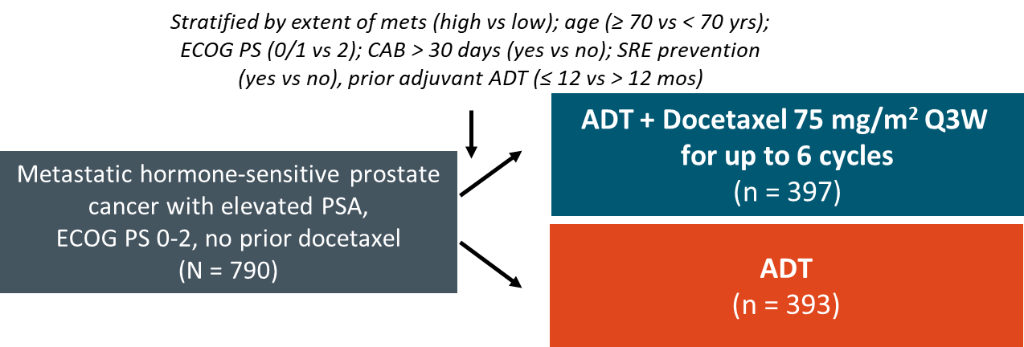
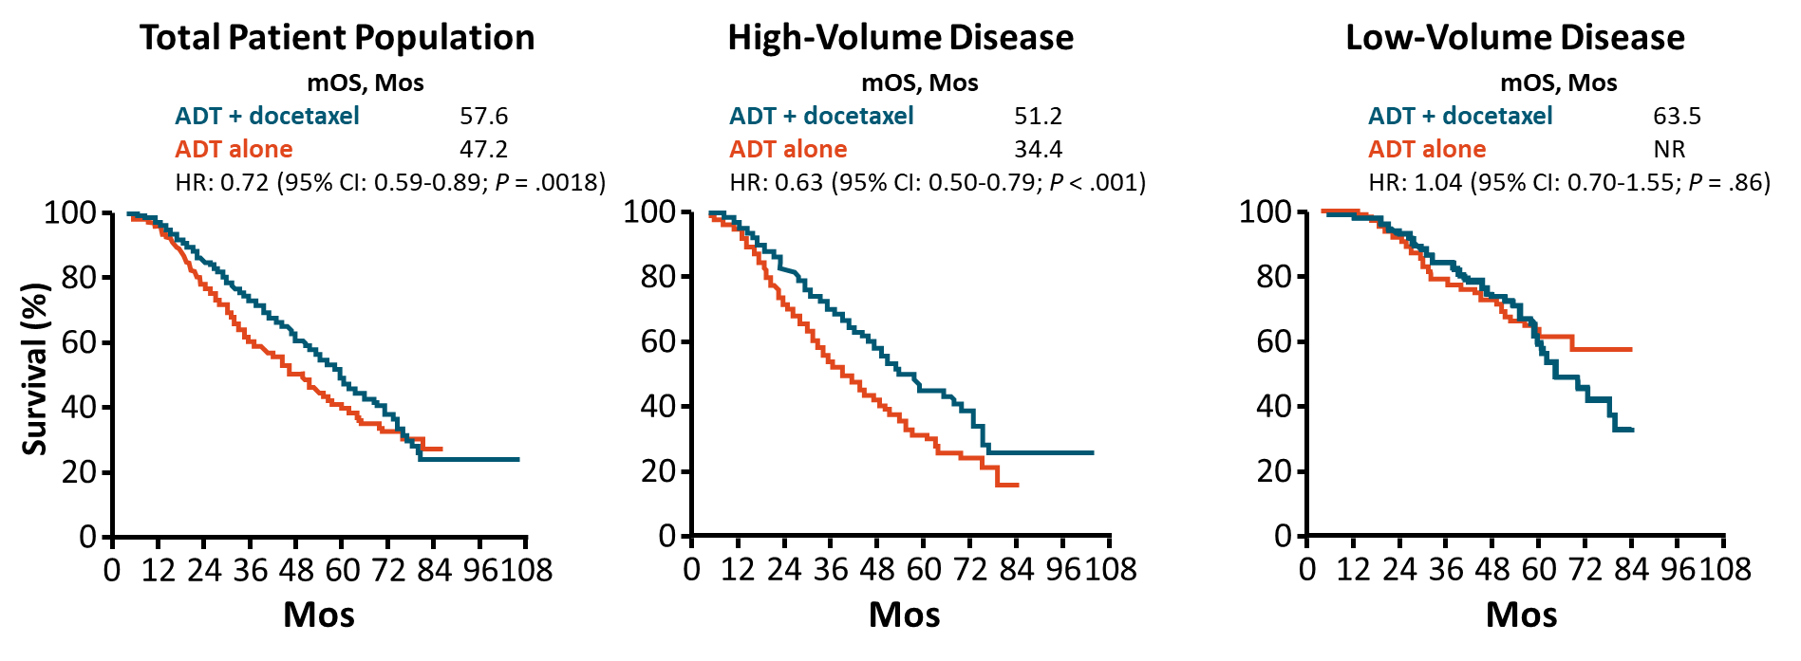
CHAARTED:
Docetaxel + ADT ya da ADT
Notes:
ADT, androgen-deprivation therapy; CAB, combined androgen blockade; ECOG, Eastern Cooperative Oncology Group; CRPC, castration-resistant prostate cancer; mets, metastases; PS, performance status; PSA, prostate-specific antigen; SRE, skeletal-related event; QoL, quality of life.

Slide 12
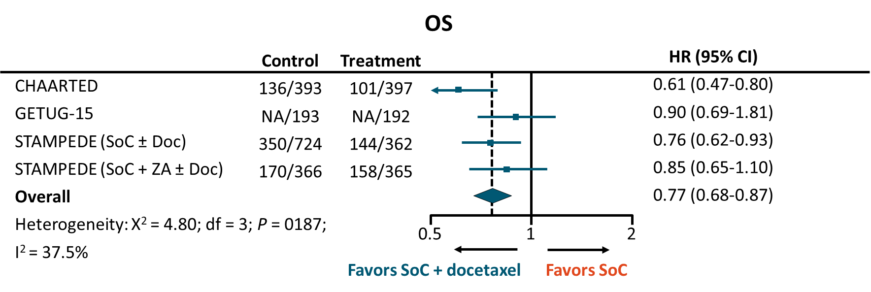
Dosetaksel Meta-Analiz:
2992 hasta ve 1271 olay içeriyor.
4 yılda 9% absolute iyileşme

Slide 13
LATITUDE:
Abiraterone Acetate + ADT ya da Placebo + ADT
Randomized, double-blind phase III (N = 1199)
rPFS
OS
100
100
90
90
80
80
Abiraterone
70
Abiraterone
70
60
60
50
50
PFS (%)
OS (%)
40
Placebo
40
Placebo
30
30
20
20
10
HR: 0.47 (95% CI: 0.39-0.55; P < .001)
10
HR: 0.62 (95% CI: 0.51-0.76; P < .001)
0
0
0
4
8
12
16
20
24
28
32
36
40
0
6
12
18
24
30
36
42
Mos
Mos

Slide 14
STAMPEDE:
Randomized, open-label, multiarm, multistage phase II/III
(N = 1917)
Patients Eligible for STAMPEDE
Newly Diagnosed M1 Patients
All Other Patients
Randomization
Randomization
A
ADT
A
ADT (+ RT if N0 M0)
B
Arm A + zoledronic acid
B
Arm A + zoledronic acid
C
Arm A + docetaxel
C
Arm A + docetaxel
E
Arm A + ZA + docetaxel
E
Arm A + ZA + docetaxel
G
Arm A + abiraterone
G
Arm A + abiraterone
H
Arm A + RT to prostate

Slide 15
STAMPEDE:
Arm G
Patients Eligible for STAMPEDE
Newly Diagnosed M1 Patients
All Other Patients
Randomization
Randomization
A
ADT
A
ADT (+ RT if N0 M0)
B
Arm A + zoledronic acid
B
Arm A + zoledronic acid
C
Arm A + docetaxel
C
Arm A + docetaxel
E
Arm A + ZA + docetaxel
E
Arm A + ZA + docetaxel
G
Arm A + abiraterone
G
Arm A + abiraterone
H
Arm A + RT to prostate

Slide 16
ENZAMET:
Enzalutamide + ADT vs NSAA + ADT
Randomized, open-label, multicenter phase III clinical trial
Stratified by volume of metastases (high vs low), antiresorptive therapy (yes vs no), ECOG PS (0/1 vs 2), comorbidities (ACE-27:
0/1 vs 2/3), study site, planned use of early docetaxel (yes vs no)
Patients with metastatic prostate cancer, starting first-line ADT (max 12 wks prior to randomization); ECOG PS 0-2;
2 cycles prior docetaxel allowed
(N = 1125)
Enzalutamide 160 mg/day +
testosterone suppression
(n = 563)
CRPC tx at PD (investigator discretion)
Follow for time to progression and OS
Evaluate
every 12 wks
Standard NSAA*+
testosterone suppression
(n = 562)
Evaluate
every 12 wks
*Bicalutamide, nilutamide, or flutamide
Davis. NEJM. 2019;381:121.

Slide 17

ENZAMET: OS
Enzalutamide
NSAA
100
80
60
Patients Alive at Mo 36, %
Enzalutamide | NSAA
80 (95% CI: 75-83) | 72 (95% CI: 68-76)
HR: 0.67 (95% CI: 052-0.86; P = .002)
OS (%)
40
20
0
0
6
12
18
24
30
36
42
48
Mos
Patients at Risk, n
Enzalutamide
NSAA
563 558 541 527 480 340 189 106 45
562 551 531 501 452 311 174 86 32
Davis. NEJM. 2019;381:121.

Slide 18
ARCHES:
Enzalutamide + ADT ya da Placebo + ADT
International, double-blind, randomized phase III trial in mHSPK
Stratified by disease volume (low vs high*), previous docetaxel for mHSPC (none vs 1-5 vs 6 cycles)
Enzalutamide 160 mg/day + ADT
(n = 574)
Patients with mHSPC, ECOG PS 0/1, on ADT for ≤ 3 mos or ≤ 6 mos if received prior docetaxel
(N = 1150)
Until radiographic PD, unacceptable toxicity, or initiation of new or investigational agent for PC
Placebo + ADT
(n = 576)
*High disease volume defined as either visceral metastases or ≥ 4 bone lesions with ≥ 1 lesion in bony structure beyond vertebral column and pelvic bone.
Primary endpoint: centrally assessed radiographic PFS
Secondary endpoints: OS, ORR, time to first SSE, PSA progression, time to new antineoplastic therapy, time to castration resistance, PSA undetectable rate
Armstrong. JCO. 2019;37:2974.

Slide 19
ARCHES: rPFS, Primary Outcome
ARCHES: rPFS, Primary Outcome
100
+
+
+
+
+
+
+
+
+
+
+
+
+
+
+
+
+
+
90
+
+
+
+
+
+
+
+
+
+
+
+
+
+
+
+
+
+
+
+
+
+
Enzalutamide + ADT
+
+
+
+
+
+
+
+
+
80
+
+
+
+
+
+
+
+
+
+
+
+
+
+
+
+
+
+
+
+
+
+
+
+
+
+
+
+
+
+
+
+
+
+
+
+
+
+
+
+
+
+
+
+
+
+
+
+
+
+
+
+
+
+
+
+
+
+
+
+
+
+
+
+
+
+
+
70
+
+
+
+
+
+
+
+
+
60
+
+
Placebo + ADT
+
+
+
+
+
+
+
+
+
+
+
+
+
+
+
+
+
+
+
+
50
+
rPFS* (%)
+
+
+
+
+
+
+
+
+
+
+
+
40
+
30
 | Enzalutamide + ADT (n = 574) | Placebo + ADT (n = 576)
Median rPFS, mos (95% CI) | NR (NR-NR) | 19.0 (16.6-22.2)
HR | 0.39 (95% CI: 0.30-0.50, P < .001)
20
+
+
10
0
0
3
6
9
12
15
18
21
24
27
30
33
Patients at Risk, n
Enzalutamide + ADT
Placebo + ADT
Mos
574
576
516
511
493
445
370
314
256
191
144
106
62
39
23
10
4
0
1
0
0
0
0
0
Armstrong. JCO. 2019;37:2974.

Slide 20
TITAN:
Apalutamide + ADT vs Placebo + ADT in mHSPC
International, randomized, double-blind, placebo-controlled phase III trial
Primary endpoints: OS, radiographic PFS
Secondary endpoints: time to pain progression, time to SRE, time to chronic opioid use, time to cytotoxic chemotherapy
Exploratory endpoints including: time to PSA progression, PFS2
Gleason score (≤ 7 vs > 7), region (NA/EU vs other), prior docetaxel (yes vs no)
Apalutamide 240 mg QD + ADT
(n = 525)
Patients with metastatic castration-sensitive prostate cancer; ECOG PS 0/1; prior ADT ≤ 6 mos for mCSPC or ≤ 3 yrs for local disease
(N = 1052)
PD
Placebo + ADT
(n = 527)
Chi. NEJM. 2019;381:13.

Slide 21
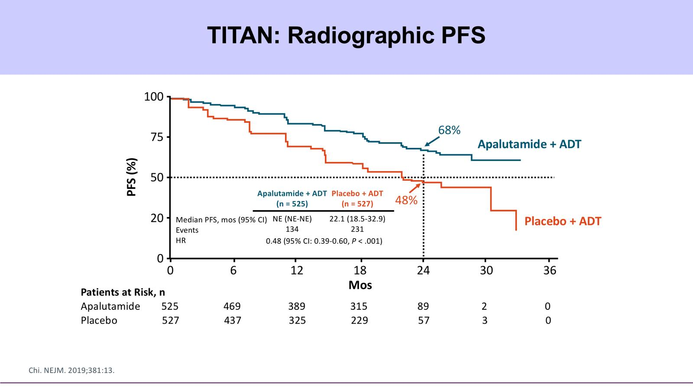
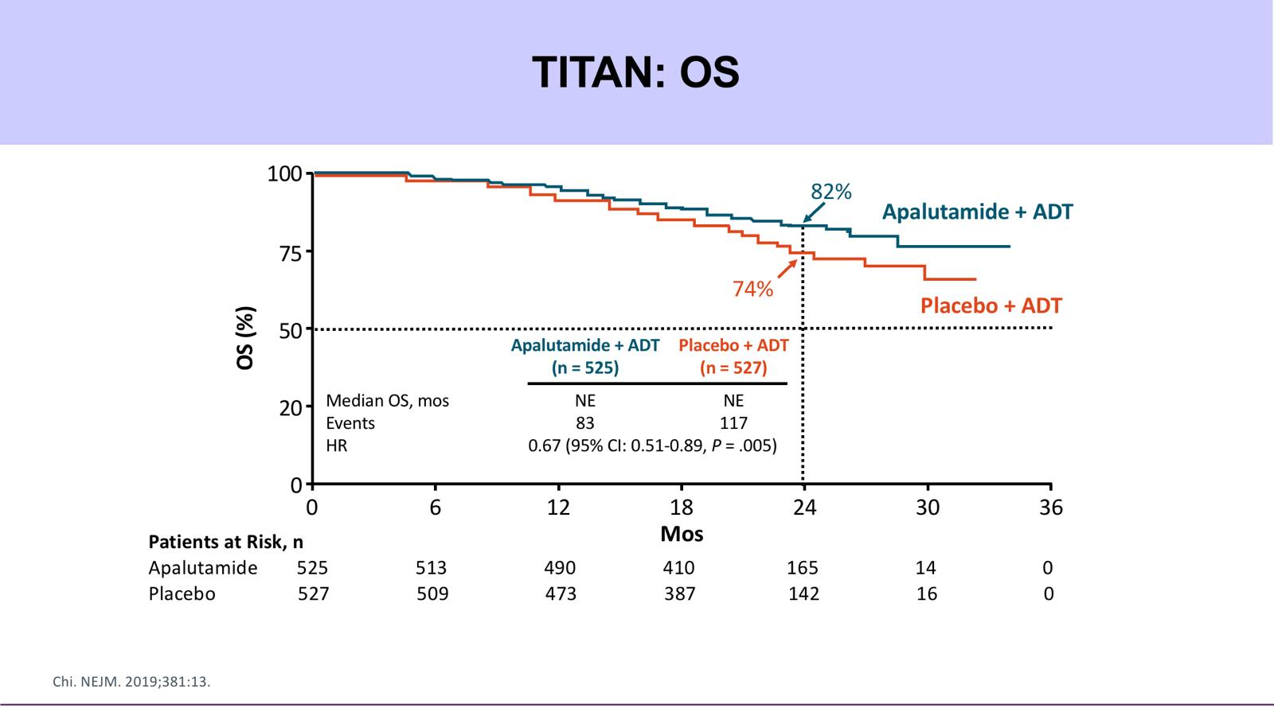
TITAN:
Apalutamide + ADT vs Placebo + ADT in mHSPC
PFS
OS

Slide 22
Dosetaksel ya da AR inhibitörleri
Etkinliği görülen bir ilaç aynı alanda daha ileri incelemeye gitmezler
Artık satış dönemidir
Akademik çalışmlara ihtiyaç vardır
Endustri çalışması beklemek mantıklı değil
Yeni gelişen bir ilaç

Slide 23
STAMPEDE:
Randomized, open-label, multiarm, multistage phase II/III
(N = 1917)
Patients Eligible for STAMPEDE
Newly Diagnosed M1 Patients
All Other Patients
Randomization
Randomization
A
ADT
A
ADT (+ RT if N0 M0)
B
Arm A + zoledronic acid
B
Arm A + zoledronic acid
C
Arm A + docetaxel
C
Arm A + docetaxel
E
Arm A + ZA + docetaxel
E
Arm A + ZA + docetaxel
G
Arm A + abiraterone
G
Arm A + abiraterone
H
Arm A + RT to prostate

Slide 24
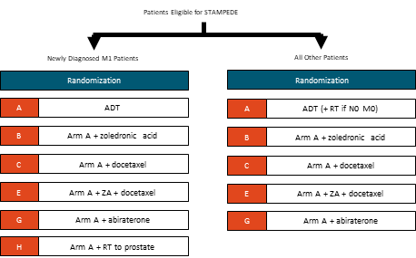
STAMPEDE:
Docetaxel ya da Abiraterone
Outcomes
Favors
SoC + AAP
Favors
SoC + DocP
100
OS
Failure-free survival
80
PFS
60
Metastatic PFS
OS (%)
40
Symptomatic skeletal events
20
Abiraterone
Docetaxel
Cause-specific survival
0
0
12
24
36
48
Mos
OS
0.5
1.0
2.0
HR
Sydes. Ann Oncol. 2018;29:1235.

Slide 25
Kombinasyon?

Slide 26
ARASENS
Phase 3 Trial: Darolutamide in mHSPC
Randomized, double-blind, placebo controlled, international trial > 300 sites in 23 countries
Primary endpoint: OS
Secondary endpoints: Time to CRPC, time to initiation of subsequent anticancer therapy, SSE-free survival, time to first SSE, time to first opioid use, time to pain progression, and time to worsening of physical symptoms
Anticipated primary completion date: June 2021
Stratified by extent of disease and alk phos levels
Patients with newly diagnosed, metastatic HSPC, ECOG PS 0 or 1
(Planned N = 1,300)
ADT + docetaxel (x 6 cycles)
+ darolutamide (600 mg PO BID)
Until PD or unacceptable toxicity
ADT + docetaxel (x 6 cycles)
+ placebo
NCT02799602.

Slide 27
NonMetastatik Prostat Kanseri
M0 KRPK
Sistemik Tedaviler
Lokal tedavi sonrası PSA nüksü
Salvage RT
Salvage Cerrahi
Ablatif tedaviler

Slide 28
Metastatik Olmayan (M0) KDPK
ADT sonrası Radyolojik Progresyon
Yeni kemik metastazı
%35
Yeni yumuşak doku metastazı
%58
Kemik+Yumuşak Doku Metastazı Birlikte
%6
Hussain M et al, ASCO Genitourinary Cancers Symposium, February 8-10, 2018, San Francisco, CA

Slide 29
Prostat Kanserinde PET/CT
İzleyici (tracer) | Yarılanma Ömrü | Etki Mekanizması | İtrah | Duyarlılık | Özgüllük
Ga-68 PSMA | 68dk | PSMA analogu | Renal | %76-86 | %86-100
F-18 NaF | 110dk | Kemik matriksine adsorbsiyon | Hepatik | %87-100 | %62-89
F-18 Flusiklovin | 110dk | Aminoasit transportu | Renal | %37-90 | %40-100
C-11 kolin | 20dk | Hücre zarı sentezi | Hepatik | %32-93 | %40-93
C-11 asetat | 20dk | Lipid sentezi | Akciğer | %59-69 | %83-98
Sınırlılıklarına rağmen, tedavi kararlarını değiştirebilirler.²
1. Mohler JL et al, NCCN Guidelines on Prostate Cancer, 2018 v3.0. 2. Mottet N et al, EAU – ESTRO – SIOG - ESUR Guidelines on Prostate Cancer, 2017.

Slide 30
PSA Katlanma Zamanı ve Prognoz
1.0
PSADT < 6.3 mos
PSADT 6.3-8.8 mos
PSADT > 18.8 mos
0.8
0.6
Patients With Bone Metastases or Dead (%)
0.4
0.2
0
0
0.5
1.0
1.5
2.0
2.5
3.0
Yrs

Slide 31
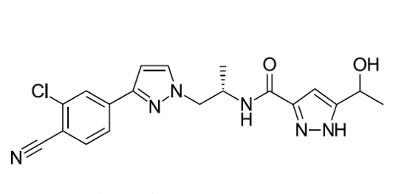
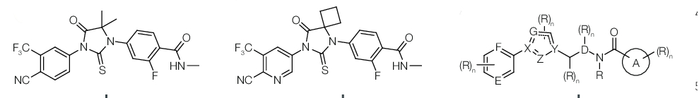
Yeni Nesil Androjen Reseptör İnhibitörü
Apalutamide
Enzalutamide
Darolutamide

Slide 32
Randomize Çalışmalar
Apalutamide (SPARTAN)
Enzalutamide (PROSPER)
Darolutamide (ARAMIS)
Patients with nmCRPC
2:1
Primary Endpoint: MFS
Placebo
Criterion | SPARTAN (Apalutamide)^{[1-3]} | PROSPER (Enzalutamide)^{[4-7]} | ARAMIS (Darolutamide)^{[8,9]}
Seizure history | Excluded, including predisposing conditions | Excluded, including predisposing conditions | Allowed, including predisposing conditions
LN involvement | Pelvic LN progression not considered MFS event | Pelvic LN progression was considered MFS event | Pelvic LN progression not considered MFS event
Bone targeting/sparing agent | Apalutamide: 10.2% Placebo: 9.7% | Enzalutamide: 10.2% Placebo: 10.4% | Darolutamide: 3% Placebo: 6%
PSA blinding | Yes | Yes | No
Secondary endpoints | Time to mets, PFS, TTP, OS, time to first new chemo | Time to PSA progression, PSA RR, time to first neoplastic therapy, QoL, OS, safety | OS, time to pain progression, time to chemo, time to first symptomatic SRE
Crossover unblinding | 76 patients (19%) continued open-label apalutamide | 87 patients (19%) continued open-label enzalutamide | 170 patients (31%) continued open-label darolutamide
1. Small. ASCO 2020. Abstract 5516. 2. NCT01946204. 3. Smith. NEJM. 2018;378:1408. 4. NCT02003924. 5. Sternberg. NEJM. 2020;382:2197.
6. Hussain. NEJM. 2018;378:2465. 7. Sternberg. NEJM. 2020;382:2197. 8. Fizazi. ASCO 2020. Abstract 5514. 9. Fizazi. NEJM. 2019;380:1235.

Slide 33
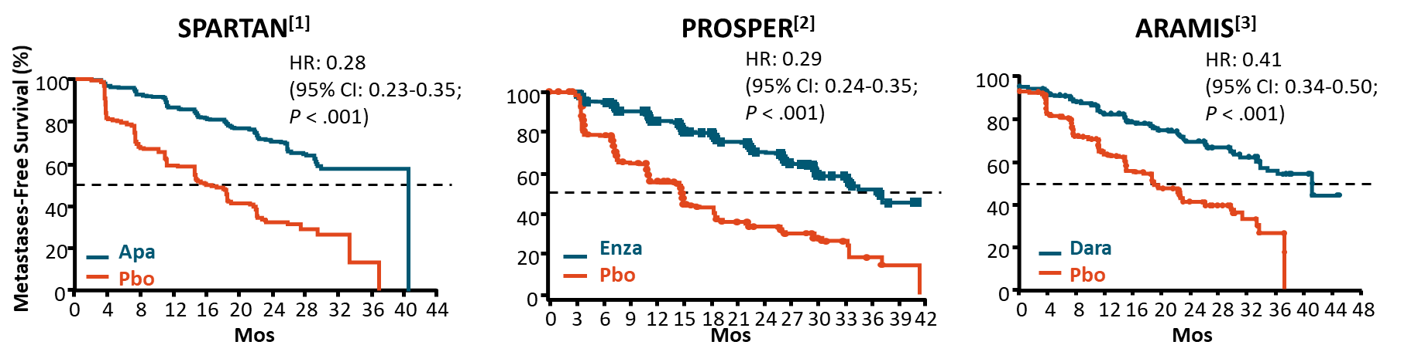
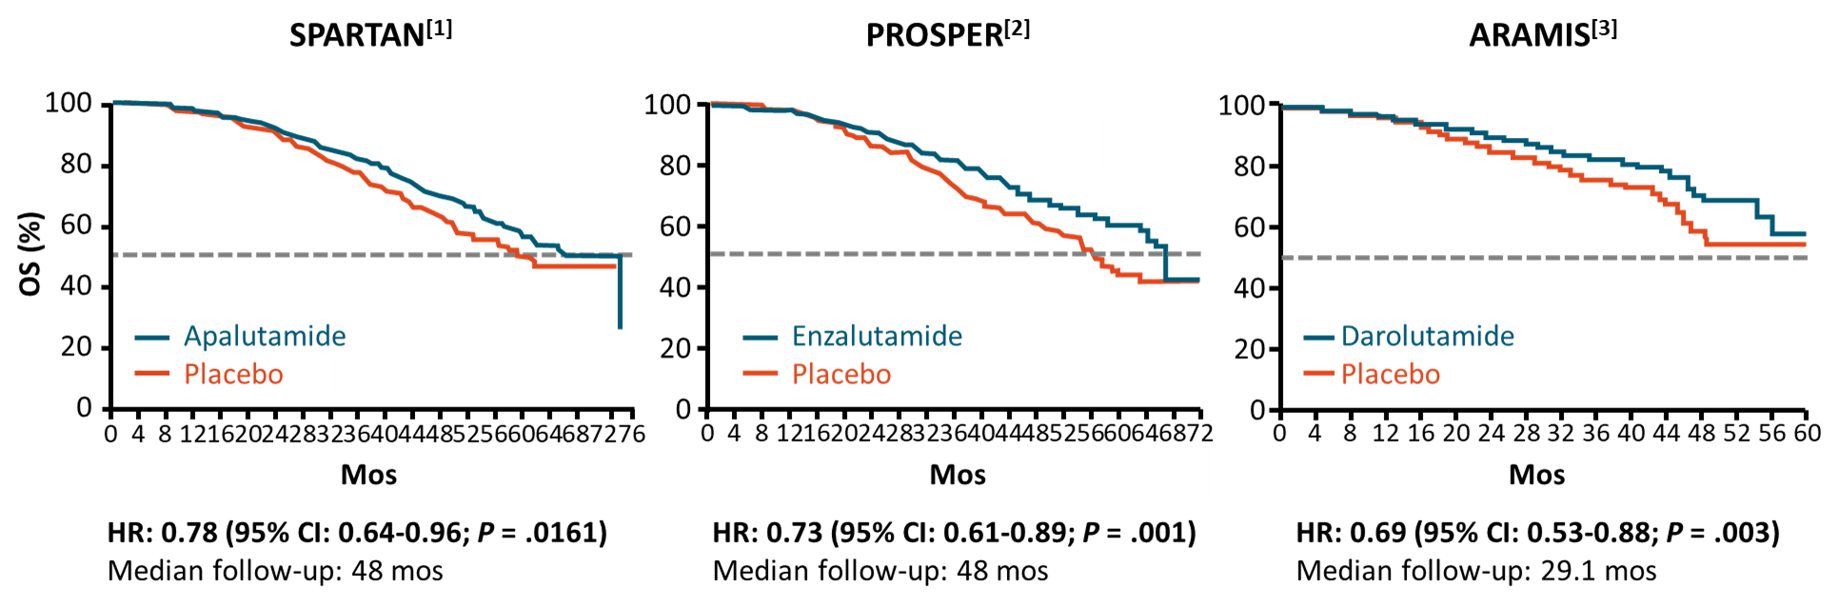

Slide 34
Metastatic KRPK

Slide 35


KDPK tanım
Serum Testosteron düzeyi < 50ng/dl (veya 1.7 nmol/L)
VE
a) Biyokimyasal progresyon: PSA’da yükselme
  - 3 kez üst üste yükselme ve
  - En az birer hafta arayla ve
  - En az iki kez en düşük düzeyin %50 üzerinde artış ve
  - PSA > 2ng/mL
VE/VEYA
b) Radyolojik progresyon
- Yeni lezyonların oluşması veya
- Kemik görüntülemesinde iki veya daha fazla yeni kemik lezyonu veya RECIST’e göre yumuşak doku lezyonu
1 hafta
1 hafta
PSA %50 ↑
PSA %50 ↑
PSA %50 ↑
2017
Mottet N et al, EAU–ESTRO-ESRU-SIOG Guidelines on Prostate Cancer, 2017.

Slide 36
mKDPK FDA Onaylı İlaçlar
AR İnhibitör
Abiraterone (2011),
Sitotoksik
Docetaxel (2004),
İT
Sipuleucel-T (2010)
Pembrolizumab (2017)
Radiofarmatik
Radium-223 (2013)
PARP inhibitor
Olaparib (2020),
Enzalutamide (2012)
cabazitaxel (2010),
mitoxantrone (1996),
estramustine (1981)
Rucaparib (2020)

Slide 37
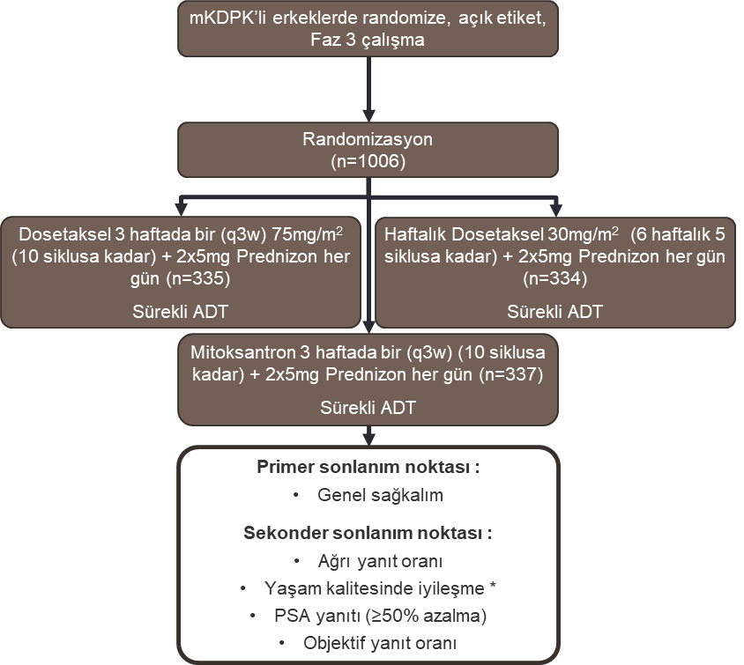
Dosetaksel: TAX-327
TAX-327 mKDPK’li erkeklerde randomize, açık etiket, Faz 3 çalışmadır.
Dahil olma kriterleri:
Konfirme edilmiş prostat adenoca. ve idame olarak ADT sonrası progresif metastatik hastalık
Antiandrojenlerin >4 hafta boyunca geri çekilmiş olması
PSA artışı ile gösterilen hastalık progresyonu
Karnofsky performans statüsü ≥60%
Hariç tutma kriterleri
Önceden radyoizotop veya sitotoksik ajan kullanmış olmak, başka kanser öyküsü, beyin metastazı, periferik nöropati
Tannock IF, ve ark. N Engl J Med 2004;351:1502–12.

Slide 38
TAX-327
Genel sağkalım (OS) için Kaplan-Meier eğrileri
100
80
60
40
20
0
3 haftada bir dosetaksel
Haftalık dosetaksel
2.5 AY
Mitoksantron
Genel sağkalım (%)
Median
Sağkalım HR
18.9 0.76
17.3 0.91
16.4 —
0
3
6
9
12
15
18
21
24
27
30
33
Risk altındaki hasta sayısı
3 haftada bir Dosetaksel
Haftalık dosetaksel
Mitoksantron
D q3w:
D q1w:
M:
Zaman [ay]
0.009
0.36
—
335
296
217
104
37
5
334
297
200
105
29
4
337
297
192
95
29
3
Tannock IF, ve ark. N Engl J Med 2004;351:1502–12.

Slide 39
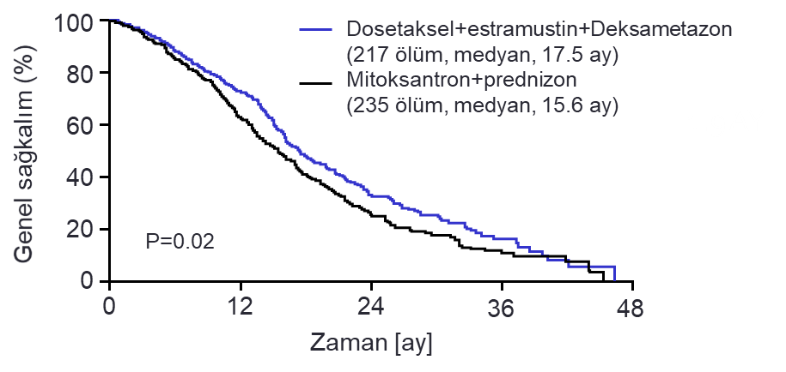
Dosetaksel: SWOG9916
mKDPK hastalarda Prospektif, Randomize, Faz 3 çalışma
Randomize hastalar
(Tedaviye niyetlenilen popülasyon) (ITT)
(N=674)
Dosetaksel + Estramustin + Deksametazon 21 günde bir (3w) (n=338)
Sürekli ADT
Mitoksantron + Prednizon 21 günde bir (3w)(n=336)
Sürekli ADT
Primer sonlanım noktası:
Genel sağkalım
Sekonder sonlanım noktası :
Progresyonsuz sağkalım
Objektif yanıt oranı
PSA yanıt oranı (≥50% düşüş)
Yan etkiler

Slide 40
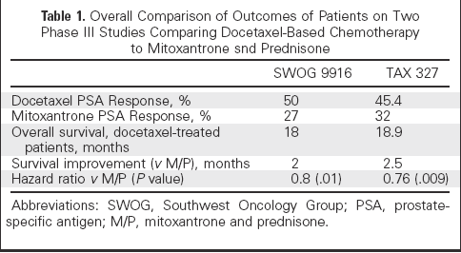
Docetaksel Çalışmaları Tutarlıdır

Slide 41
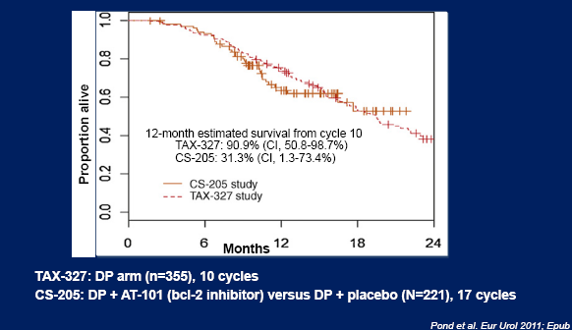
Docetaksel 10 küre kadar

Slide 42
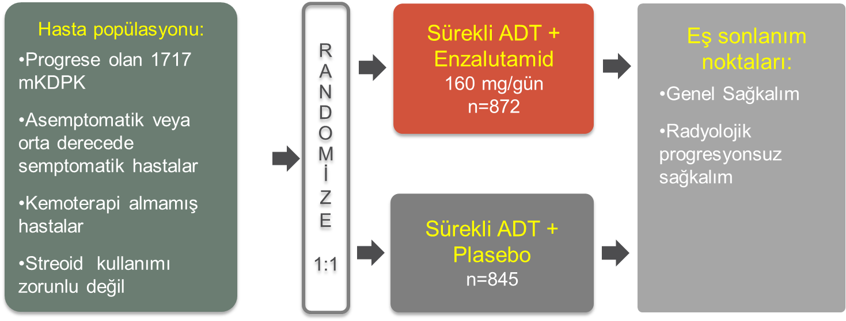
Enzalutamid (PREVAİL)

Slide 43
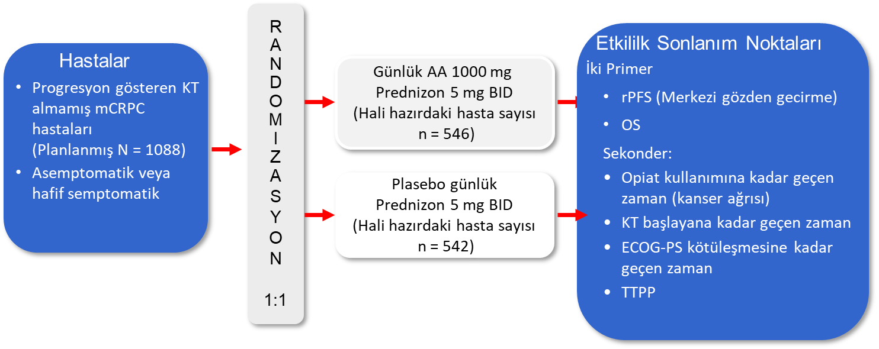
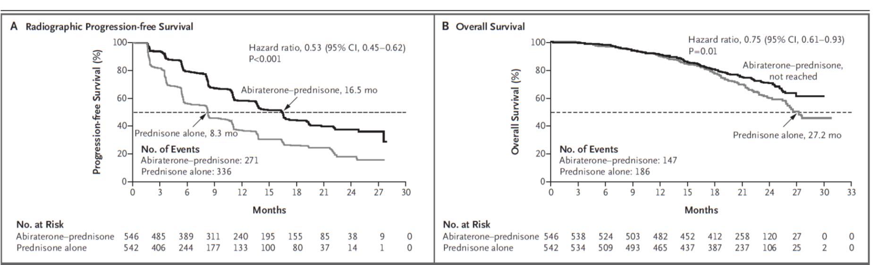
Abirateron COU-AA-302

Slide 44
R-223 ALSYMPCA
100
Radyum-223
Plasebo
80
HR=0.66 (%95 GA: 0.52–0.83)
p<0.001
60
İskeletle ilgili semptomatik olay olmayan hastalar (%)
40
R
A
N
D
O
M
İ
Z
A
S
Y
O
N
2:1
  Faz 3
  921 hasta
  Progresif, semptomatik KDPK
  Önceden dosetaksel almış, dosetaksele uygun değil veya reddetmiş
  ≥2 kemik metastazı
  Bilinen visseral metastaz yok
  En iyi SB alan
Altı enjeksiyon
Radyum-223 klorür
4 haftada bir IV 50 kBq/kg
(n=614)
20
0
100
0
3
6
9
12
15
18
21
24
27
30
Zaman (ay)
80
HR=0.70 (%95 GA: 0.58–0.83)
p<0.001
Altı enjeksiyon plasebo
4 haftada bir
(n=307)
60
Genel Sağkalım (%)
40
20
0
0
3
6
9
12
15
18
21
24
27
30
33
36
39
Zaman (ay)

Slide 45
Köşe Taşı: Dosetaksel
Tarihsel değişimin başlangıcı
2004
İlk sistemik tedavi
Dosetaksel Mitoxantron dan üstün
Türkiyede geri ödeme ana koşulu
AR inhibitörü öncesi gerekli
Endikasyon dışı
Steroid zorunluluğu getirdi

Slide 46
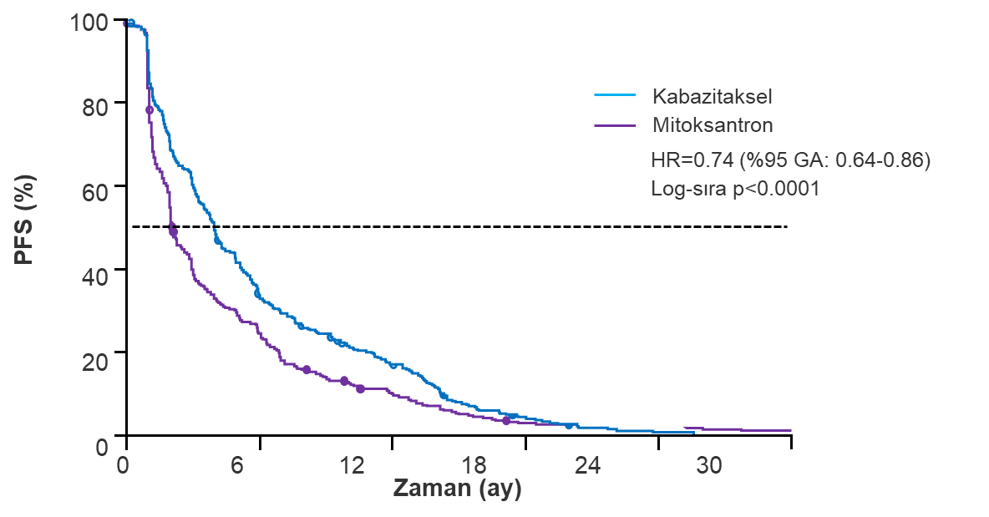
Tropic:
Kabasitaksel ya da Mitoxantron
R
A
N
D
O
M
İ
Z
A
S
Y
O
N
1:1
25 mg/m² kabazitaksel IV
3 haftada bir
+ Prednizon 10 mg QD
(n=378)
Primer sonlanım noktası:
Genel sağkalım
Sekonder sonlanım noktaları:
PSA yanıtı
PSA progresyonu
Tümör yanıtı (RECIST)
Ağrı yanıtı
  Faz 3
  Konfirme edilmiş, progrese mKDPK'li 755 hasta
  Dosetaksel sonrası
  ECOG PS 0-2
  Önceden mitoksantron tedavisi, radyoterapi ve 4 hafta içinde kanser tedavisi (LHRHa dışında) olanlar alınmamıştır
12 mg/m² mitoksantron IV
3 haftada bir
+ Prednizon 10 mg QD
(N=377)
100
80
60
40
20
0
Kabazitaksel
Mitoksantron
HR=0.70 (%95 GA: 0.59-0.83)
Log-sıra p<0.0001
Genel sağkalım (%)
0 6 12 18 24 30
Zaman (ay)

Slide 47
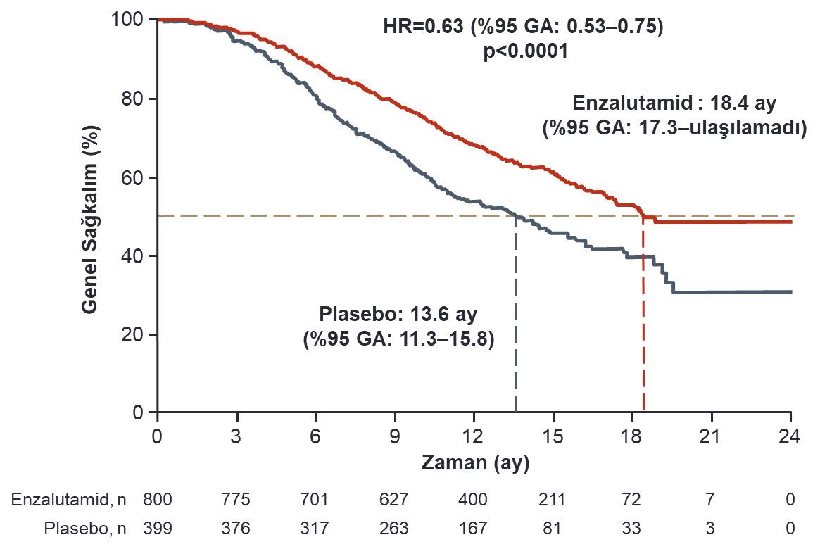
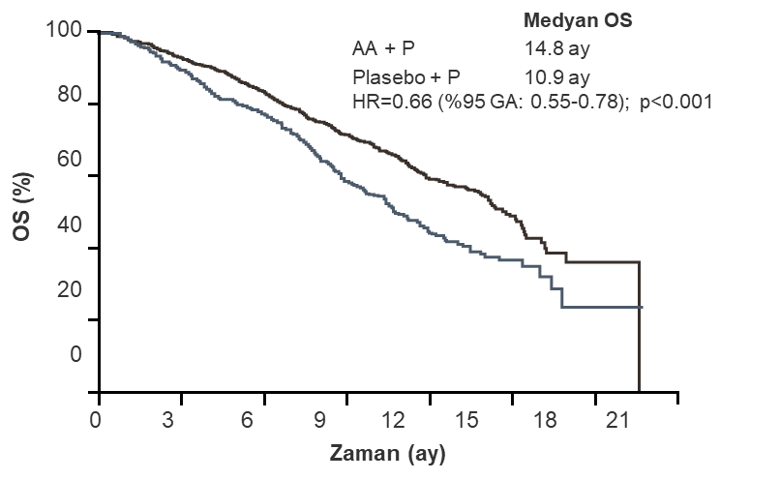
Post Docetaksel
Abirateron COU-AA-301
Enzalutamid AFFIRM

Slide 48
CARD Trial:
Phase IV Trial of Cabazitaxel yada Abiraterone or Enzalutamide
Progresif mKDPK Post Dosetaksel
Stratified by ECOG PS (0/1 vs 2), time to progression of prior alternative ARTA (≤ 6 mos vs > 6-12 mos), timing of prior
AR-targeted therapy (before vs after docetaxel)
Patients with mCRPC previously treated with
≥ 3 cycles of docetaxel and disease progression after
≤ 12 mos on abiraterone or enzalutamide (before or after docetaxel)
(N = 255)
Cabazitaxel 25 mg/m² Q3W
+ Prednisone + G-CSF
(n = 129)
Until PD
Enzalutamide 160 mg QD or
Abiraterone 1000 mg QD + Prednisone 5 mg BID
(n = 126)
Primary endpoint: imaging-based PFS
Secondary endpoint: OS, PFS, PSA response, tumor response, time to SSE, pain response, and safety
de Wit. NEJM. 2019;381:2506.

Slide 49
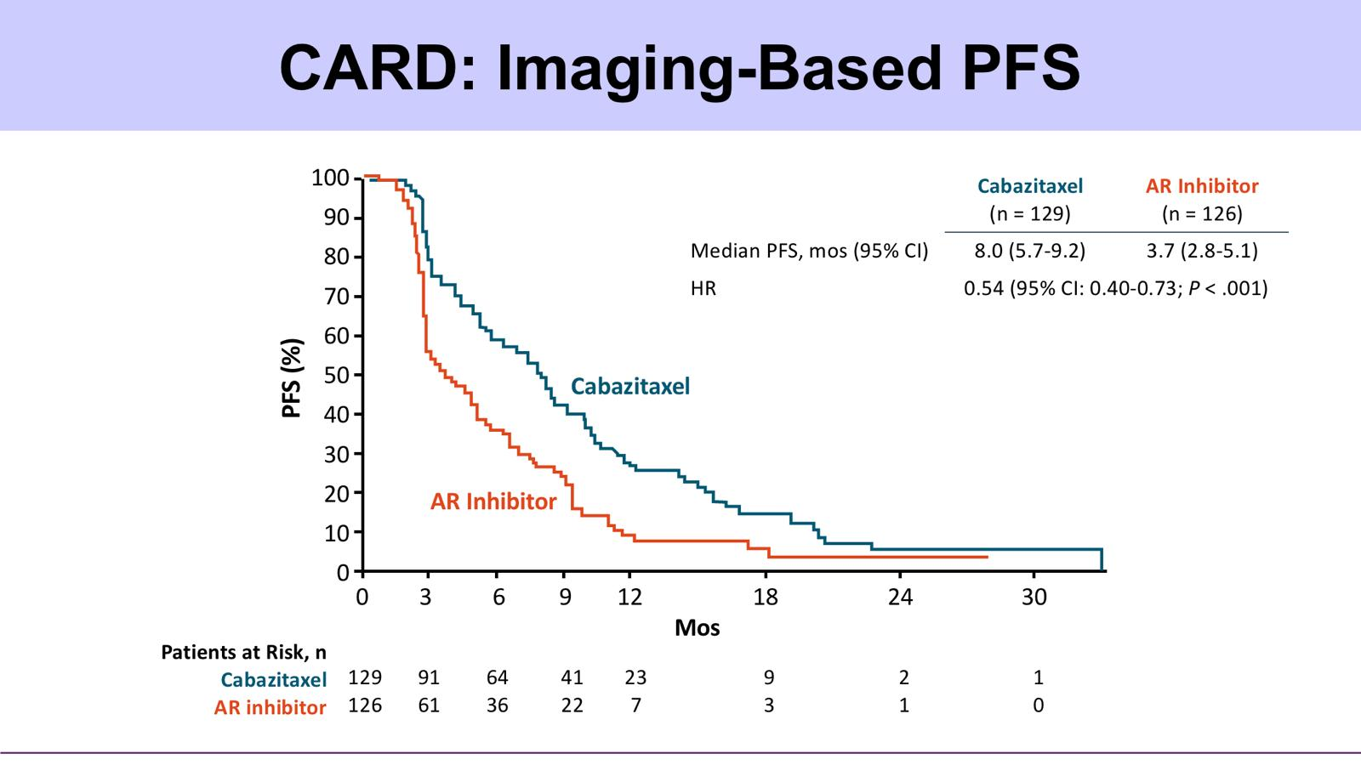
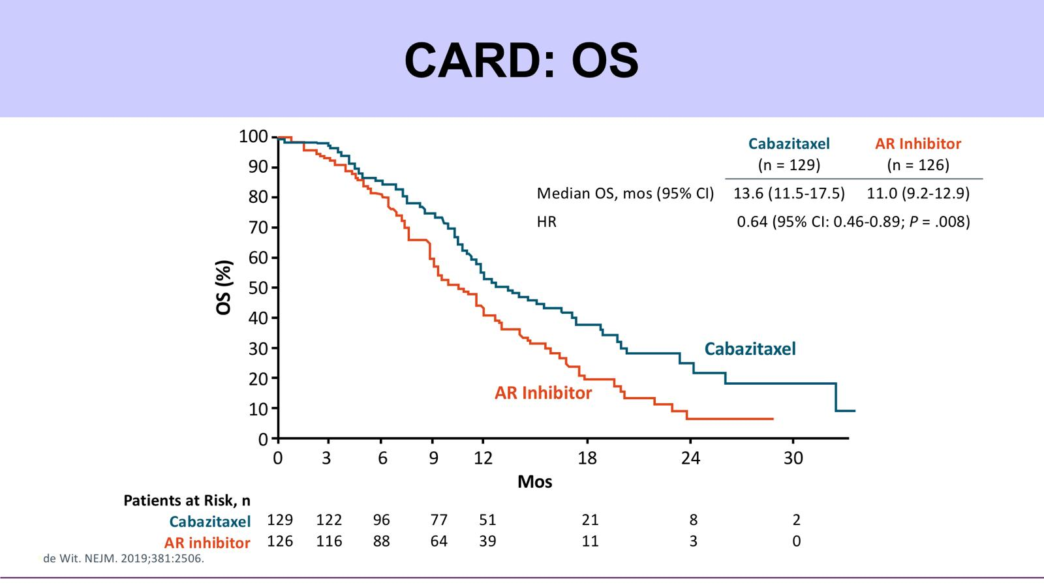
Post Docetaksel: CARD Trial:
Phase IV Trial of Cabazitaxel yada Abiraterone or Enzalutamide
Progresif mKDPK
PFS
OS

Slide 50
Primer Direnç
Post Docetaksel
Progresyon: PSA+klinik+radyolojik
Abirateron (Cou-AA-301)
Enzalutamid (AFFIRM)
100
90
80
70
60
50
40
30
20
10
0
100
90
80
70
60
50
40
30
20
10
0
Her 3 hastadan birinde Primer Direnç
Her 4 hastadan birinde Primer Direnç
Progression-free Survival (%)
Abirateron
Plasebo
Enzalutamid
Plasebo
0
3
6
9
12
15
0
3
6
9
12
15
18
21
24
Zaman (ay)
Zaman (ay)
De Bono et al. N Engl J Med 2011; 364: 1995-2005
Soher H et al. N Engl J Med 2012 (epub ahead of print)

Slide 51
AR-V7
AR-V7 pozitif hastalarda hormonal tedavilere cevap verme oranı %0’dır.
Enzalutamid n:31
Abirateron n:31
†
†
†
AR-V7 positive
AR-V7 negatif
AR-V7 positive
AR-V7 negatif
100
*
*
*
†
100
*
*
*
*
†
PSA cevap oranı:
AR-V7 (+) %0
AR-V7(-) %52.6
P:0.004
†
PSA cevap oranı:
AR-V7 (+) %0
AR-V7 (-) %68
P:0.004
PSA % değişimi
†
†
PSA % değişimi
50
†
50
†
†
†
†
†
†
†
0
†
0
†
-50
†
†
†
†
-50
-100
†
†
-100

Slide 52
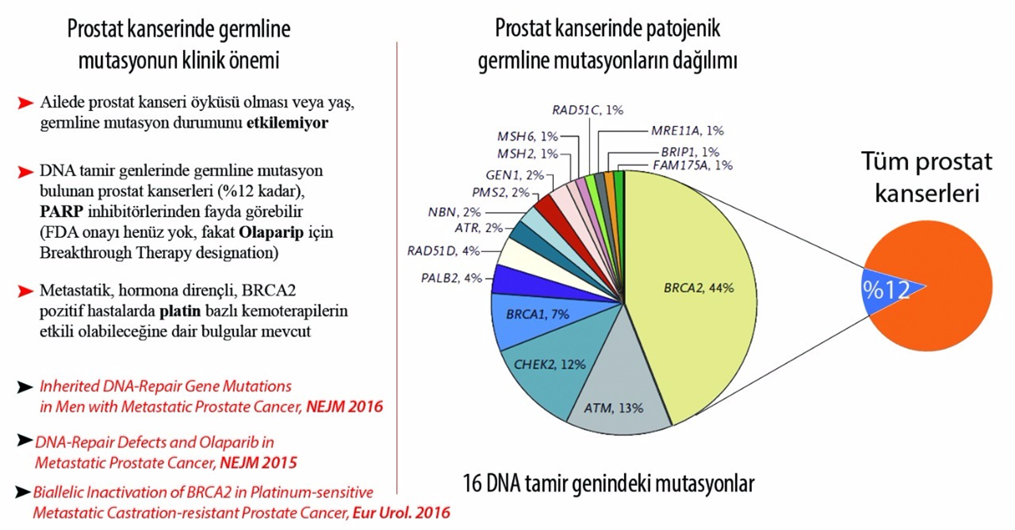
Prostat kanseri ve Biomarkır
Prostat Kanserinde Germline Mutasyonları

Slide 53
Mutasyonlar 16 gen
Distribution of Presumed Pathogenic Germline Mutations^{[2]}
RAD51C, 1%
MSH6, 1%
MRE11A, 1%
MSH2, 1%
BRIP1, 1%
GEN1, 2%
FAM175A, 1%
PMS2, 2%
NBN, 2%
ATR, 2%
RAD51D, 4%
PALB2, 4%
BRCA1, 7%
BRCA2, 44%
CHEK2,
12%
ATM, 13%

Slide 54
PROfound:
Progresif mKDPK: Olaparib ya da Dr. Seçimi
Stratified by previous taxane (yes vs no) and measurable disease (yes vs no)
Olaparib 300 mg BID
(n = 162)
Cohort A: BRCA1,
BRCA2, or ATM
alterations
(n = 245)
Patients with mCRPC and progression on prior NHA; harboring gene alterations with a role in HRR†
(N = 387)
2:1
PD
by BICR
Physician’s Choice*
(n = 83)
Crossover allowed upon progression on physician’s choice therapy
Cohort B: Other
alterations
(n = 142)
Olaparib 300 mg BID
(n = 94)
2:1
PD
by BICR
Physician’s Choice*
(n = 48)
*Enzalutamide 160 mg QD or abiraterone acetate 1000 mg QD plus prednisone 5 mg BID.
†BRCA1/2, ATM, BRIP1, BARD1, CDK12, CHEK1, CHEK2, FANCL, PALB2, PPP2R2A, RAD51B, RAD51C, RA51D, or RAD54L.
Primary endpoint: radiographic PFS in cohort A by BICR using RECIST 1.1 and PCWG3
Secondary endpoints: radiographic PFS in both cohorts, confirmed radiographic ORR in cohort A, time to pain progression in cohort A, OS in cohort A
de Bono. NEJM. 2020;382:2091.

Slide 55
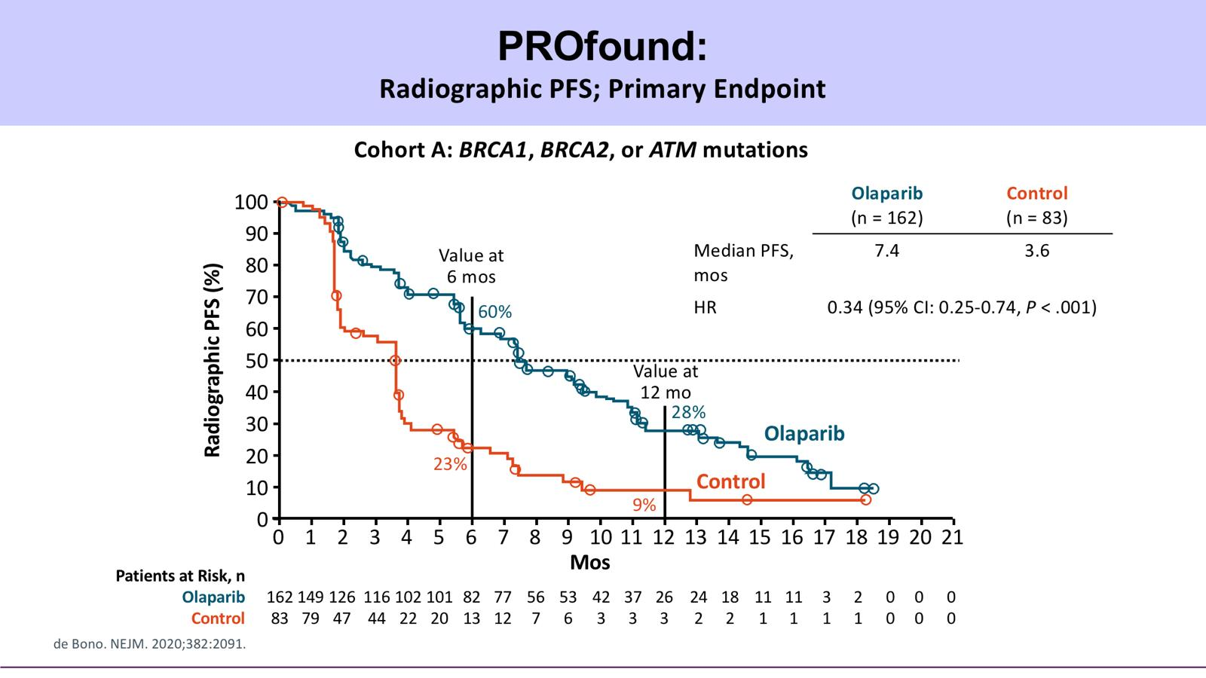
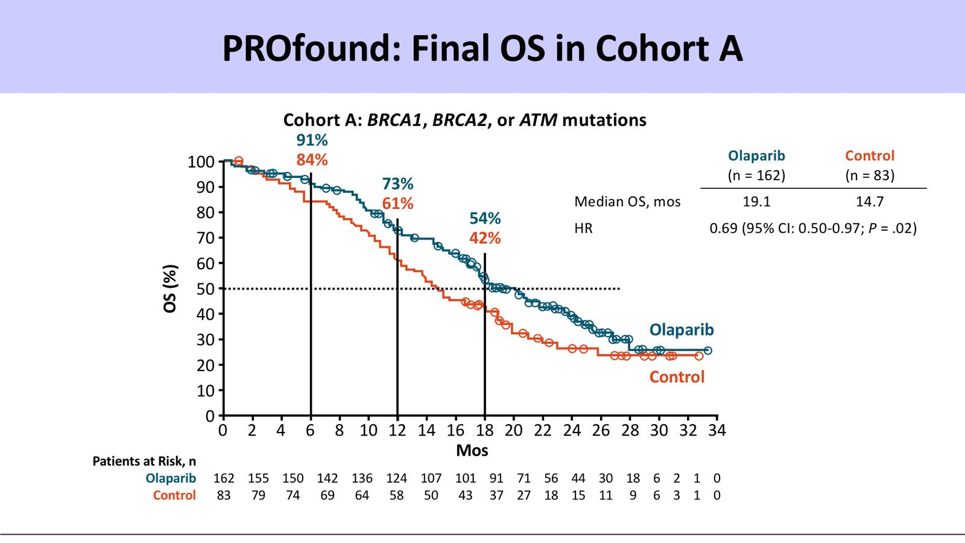
PROfound:
Olaparib yada Dr Seçimi
PFS
OS

Slide 56
TRITON2:
Rucaparib mKDPK HRR +
International, multicenter, open-label phase II study
Patients with mCRPC and deleterious somatic or germline alteration in HRR genes*; progression on AR-directed tx† for PC and 1 prior line of taxane-based CT for CRPC; no prior PARPi, mitoxantrone, cyclophosphamide, or platinum-based CT; ECOG PS 0/1
(N = 190‡)
Rucaparib 600 mg BID in 28-d cycles§
Until radiographic progression or discontinuation for other reason
*Local or central testing of blood or tumor samples for alterations in HRR genes: BRCA1, BRCA2, ATM, BARD1, BRIP1, CDK12, CHEK2, FANCA, NBN, PALB2, RAD51, RAD51B, RAD51C, RAD51D, RAD54L. †Abiraterone, enzalutamide, or apalutamide. ‡Enrollment cutoff: February 28, 2019. §Assessments: tumor Q8W for 24 wks, then Q12W; PSA Q4W.
Primary endpoints
  Among patients with measurable disease at BL: centrally assessed, confirmed ORR per modified RECIST^{ǁ}/PCWG3
  Among patients without measurable disease at BL: locally assessed, confirmed PSA response
  (≥ 50% decrease) rate
^{ǁ}RECIST modified to include up to 10 target lesions (maximum 5 per site), excluding prostatic bed or bone lesions; MRI permitted.
Abida. ESMO 2018. Abstr 793PD. Abida. JCO. 2020;[Epub].

Slide 57
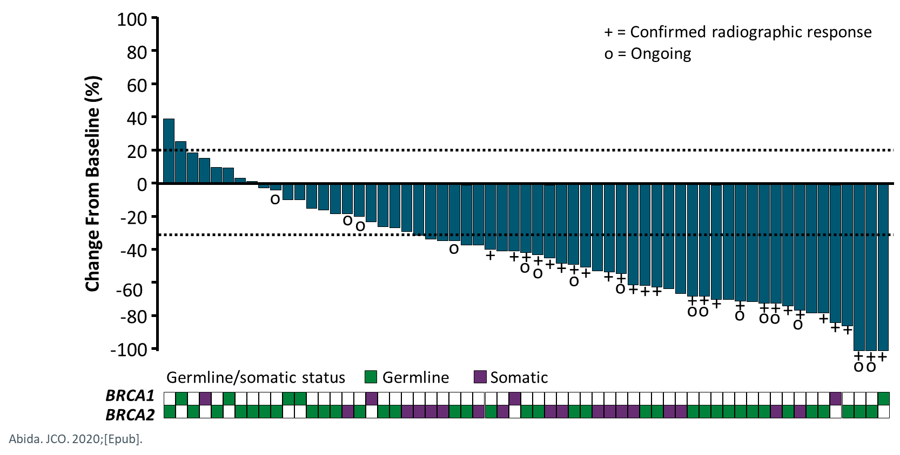
TRITON2: BRCA1/BRCA2 Cohort
Response, n (%)* | Investigator-Evaluable Population (n = 65) | IRR-Evaluable Population (n = 62)
Confirmed ORR [95% CI] | 33 (50.8) [38.1-63.4] | 27 (43.5) [31.0-56.7]
CR | 4 (6.2) | 7 (11.3)
PR | 29 (44.6) | 20 (32.3)
Stable disease | 25 (38.5) | 28 (45.2)
Progressive disease | 6 (9.2) | 6 (9.7)
Not evaluable | 1 (1.5) | 1 (1.6)
Confirmed PSA Response Rate, n (%) [95% CI] | Overall Efficacy Population (n = 115)
 | 63 (54.8) [45.2-64.1]
Abida. JCO. 2020;[Epub].

Slide 58
Özet
mHSPC
Docetaksel
Abirateron
Enzalutamide
Apalutamide
M0 KDPK
Apulatamide
Enzalutamide
Darolutamide
mKDPK
Docetaksel
Abirateron
Enzalutamid
Post docetaxel
Cabazitaxel
PARP inhibitörü
Olaparib
Rucoparib
Lu
İT
Ra-223

Slide 59
Özet
Seçenekler yeterli sayılabilir
Geri ödeme gerekliliği var

Slide 60
Ben
mHSPC
M0 KDPK
mKDPK
PARP inhibitörü
Klinik Araştırma

Slide 61
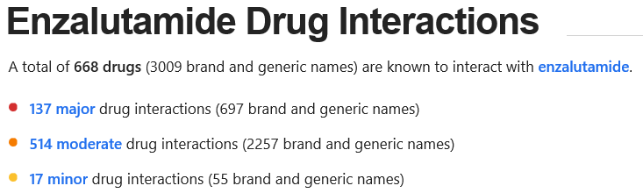
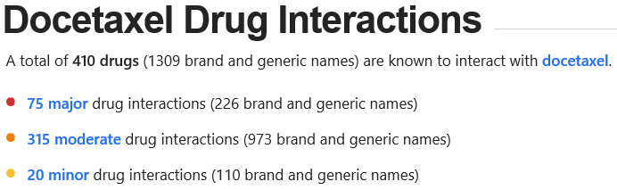
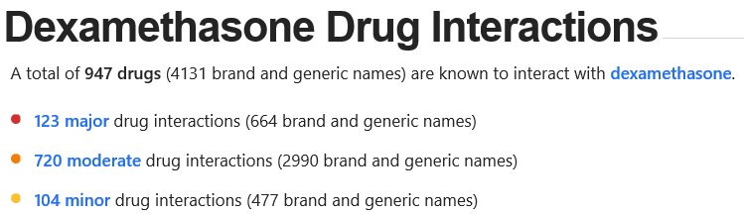
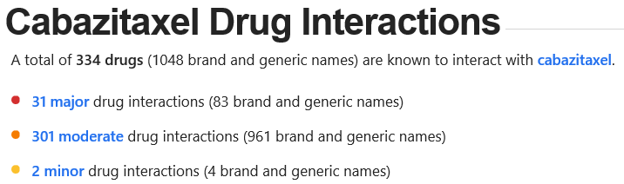
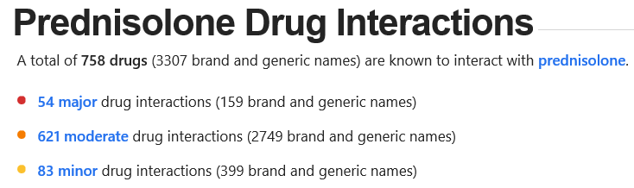
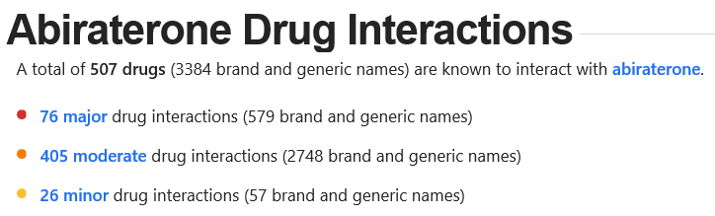
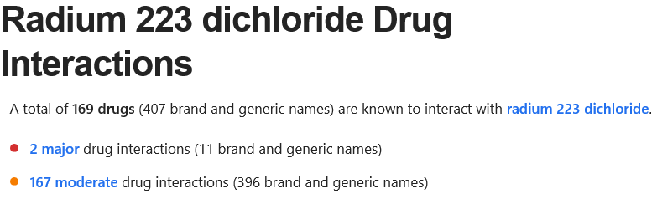
polifarması
137
75
123
31
54
76
2

Slide 62

Teşekkürler

